Slide 1

We are glad to have you
as a new rider on the
happening track of CARS24.
Fasten up your seat belt
because it’s going to be
a rocking ride.

Slide 2



Our Mission
2
Since 2015, we are helping car owners to get the best price for their car with utmost ease and authorized buyers to grow their business and become more successful.
*Strictly for internal purposes only, Ver.1-Jan'18

Slide 3

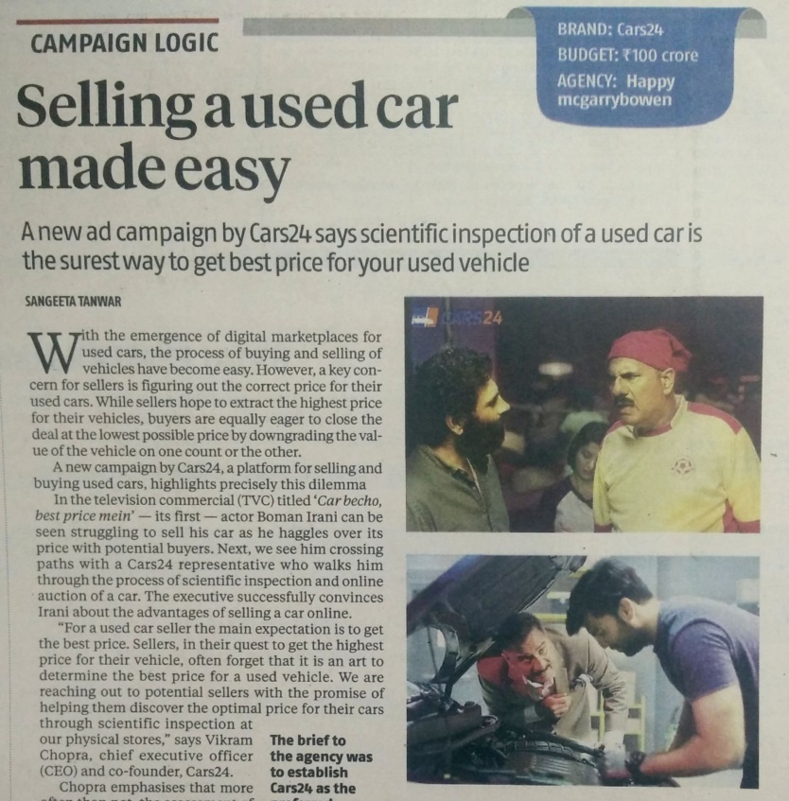
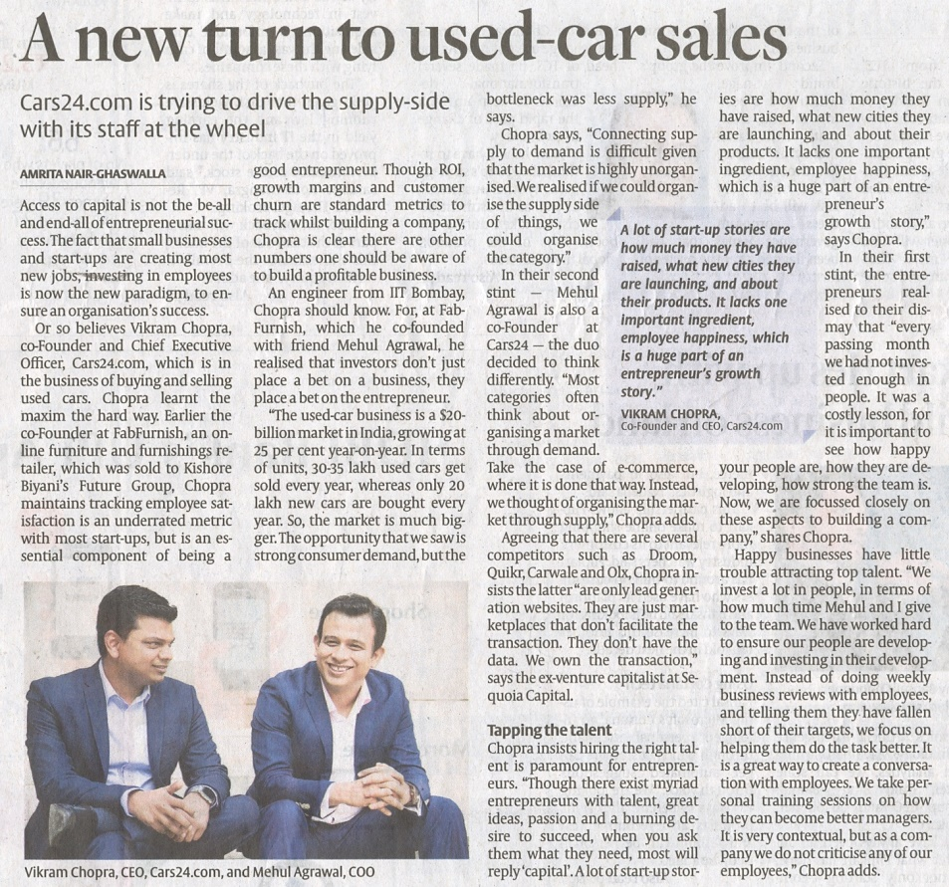
And Even In Stealth, We Show Up In News A Few Times!
3
The Hindu
Business Line
Feb 21, 2017
Business
Standard
July 20, 2017
*Strictly for internal purposes only, Ver.1-Jan'18

Slide 4
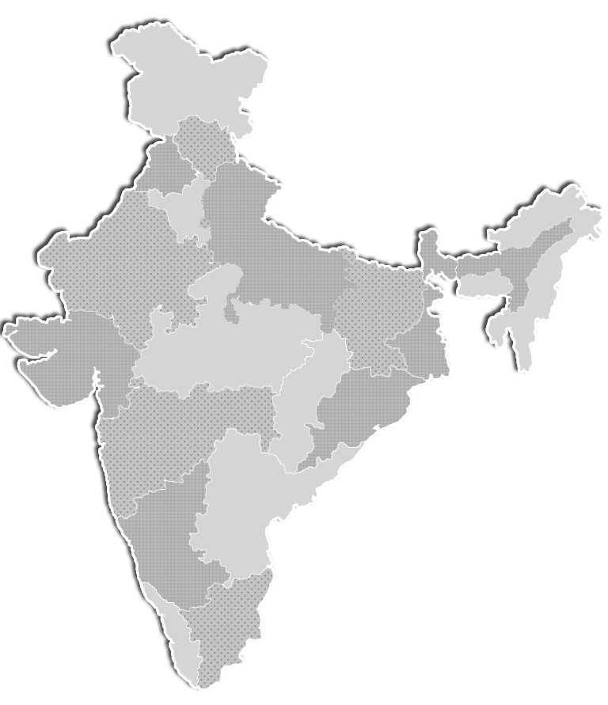

We Are Scaling Fast
4
started in august – 2015
2015 - 1 City &
4 people
2018 - 10 Cities &
645+ people
ISO 9001 – 2015
DELHI / NCR
JAIPUR
PUNE
MUMBAI
HYDERABAD
BENGALURU
*Strictly for internal purposes only, Ver.1-Jan'18

Slide 5

Our Unique Business Model &
Successful Leadership Team
*Strictly for internal purposes only, Ver.1-Jan'18

Slide 6


What Are Cars24 Lines Of Business?
6
C2B
We buy cars and offer best price with a hassle free process
B2B
Same used car dealers, who buy cars from us via C2B, we also help them sell the cars to other used car dealers, so that they can get rid of any excess inventory
Dealer
Financing
We provide dealers working capital for buying more cars (to grow their business)
*Strictly for internal purposes only, Ver.1-Jan'18

Slide 7

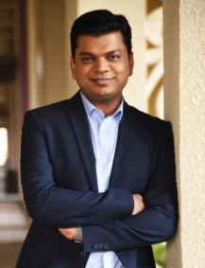


We Are Flat & Accessible. Reach Out To The Leaders For Anything
7
Vikram Chopra
Co-founder & CEO
Mehul Agrawal
Co-founder & COO
Ruchit Agarwal
VP - Operations & Finance
Gajendra Jangid
VP - Dealer Management
IIT Bombay & Wharton
Founder & MD - FabFurnish.com
Investor - Sequoia Capital
Consultant - McKinsey
IIM Calcutta
Founder & MD - FabFurnish.com
Consultant - Boston Consulting Group
Cornell University , CFA ,CA
Vice President at Bofa Merrill Lynch
Corporate Finance - Aetna and Infosys
IIT Bombay
Business Unit Head - Schlumberger
Investor in startups
(e.g. Housing.com)
*Strictly for internal purposes only, Ver.1-Jan'18

Slide 8
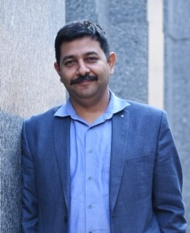
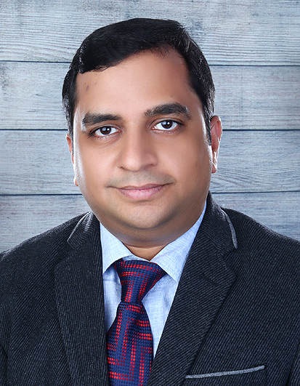

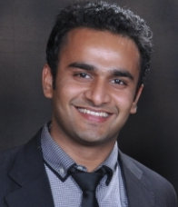
We Are Flat & Accessible. Reach Out To The Leaders For Anything
8
Ashish Thapliyal
CTO
Anuj Kumar Maheshwari
Director - Finance
Dhawal Parate
Associate Director
Abhinav Gupta
Associate Director
Chief Technical officer - FabFurnish.com, Gaadi.com
Chartered Accountant
Oravel Stays Pvt Ltd (OYO Rooms) & Flipkart Internet Pvt Ltd.
IIT Delhi
Venture Capitalist
Founder of 2 companies
IIT Calcutta
ITC Ltd & Colgate Palmolive
*Strictly for internal purposes only, Ver.1-Jan'18

Slide 9
Code Of Conduct
*Strictly for internal purposes only, Ver.1-Jan'18

Slide 10

Just Like Me : It Is Important To Respect Each Other
10
A reflection called “Just Like Me”, which asks you to consider:
This person has beliefs, perspectives, and opinions, just like me.
This person has hopes, anxieties, and vulnerabilities, just like me.
This person has friends, family, and perhaps children who love them, just like me.
This person wants to feel respected, appreciated, and competent, just like me.
This person wishes for peace, joy, and happiness, just like me.
We should help each other at workplace like our family because that makes a workplace a happy workplace and you are the best judge to decide that what ideal behavior will help in building such robust culture ☺
*Strictly for internal purposes only, Ver.1-Jan'18

Slide 11

To Build Up This Culture : Few Do’s & Don’ts Are
11
DO’S | DON’TS
Lead by merit | Not by authority
Listen to all opinions/inputs and promote innovation | Don’t penalize failure/judge
Disagree and discuss | Don’t disrespect
Prioritize tasks wisely | Don’t waste time
Do take genuine care of your internal and external customers | Don’t deviate from processes
Do ask | Don’t gossip
We would love to hear more from you…...
*Strictly for internal purposes only, Ver.1-Jan'18

Slide 12

Code Of Conduct : Policy On Official Conduct & Disciplinary Action
12
This policy explains about how our employees should follow the guidelines on their conduct during working hours and/or representing CARS24 externally, in order to maintain, follow and reflect company’s high standards & values at all the time.
This policy is termed as “POLICY ON OFFICIAL CONDUCT AND DISCIPLINARY ACTION” which broadly covers the expected professional behavior from the employees while interacting with their peers, superiors, subordinates or with any other stakeholder* external to the organization. Here, *stakeholder includes all our clients, vendors, channel partners and associates.
In case of non-compliance, the disciplinary action would be taken by DAC (Disciplinary Action Committee), the intensity of which may vary from case to case.
*Strictly for internal purposes only, Ver.1-Jan'18

Slide 13
HR Policies
*Strictly for internal purposes only, Ver.1-Jan'18

Slide 14

Attendance & Leave Policy
14
Working Hours
We follow 6 days work week pattern
Attendance
To be marked through Bio-metric systems installed at each location or made available through mobile interface.
Employees must regularize attendance in case they miss to mark it on any particular day.
Leaves
Computed on calendar year basis
Total Leave Entitlement :
15 Earned Leaves (1.25 Leaves will be credited per month). For Product Mgmt. & Tech, EL is 12 (1 leave per month).
6 Sick Leaves and
6 Casual Leaves.
*Strictly for internal purposes only, Ver.1-Jan'18

Slide 15
Attendance & Leave Policy
15
TYPE OF LEAVE | DESCRIPTION | REMARKS
Earned Leave
Casual Leave
Sick Leave
Earned on accrual basis @ 1.25 leaves/month
This will not be credited at once (start of the calendar year)
This shall be credited on a pro-rata basis.
An employee can accumulate up to 45 days of earned leaves .
Up to 15 leaves can be carried forward to the next year, remaining will lapse.
An employee can avail this leave only after completing probation period.
Annual Casual Leaves are 6.
Employee joining in mid calendar year will get casual leave on pro-rata basis.
An employee can avail this leave only after completing probation period.
Annual Sick Leaves are 6.
Employee joining in mid calendar year will get sick leave on pro-rata basis.
An employee can avail this leave during probation also.
*Strictly for internal purposes only, Ver.1-Jan'18

Slide 16

Medical Policy
16
CARS24 Medical Insurance Benefit : As per salary slabs & age group.
It provides coverage of :
Rs 50,000/- for employees with salary less than Rs 3 LPA (Self- insured)
Rs 1,50,000/- for employees with salary between Rs 3 LPA – Rs 10 LPA (employee+3 family members*)
Rs 2,00,000/- for employees with salary between Rs 10 LPA – Rs 15 LPA (employee+3 family members)
Rs 3,00,000/- for employees with salary more than Rs 15 LPA (employee+3 family members)
Soft copies of the medical card will be mailed to you in 30 - 45 days of joining which will contain the UHID
*includes spouse and 2 children
Number that can be used as a reference
*Strictly for internal purposes only, Ver.1-Jan'18

Slide 17

Sexual Harassment Policy
17
For growth & success of any business, a healthy workplace & culture is vital. Keeping this in mind, CARS24, as an Organization has been founded on principles of inclusiveness and equality - access to opportunities for all, without any discrimination on the grounds of religion, race, caste, gender, or place of birth.
In pursuance of its objectives and in order to ensure that its employees can work in an atmosphere free from any kind of harassment, exploitation, or intimidation, CARS24 has drafted the Prevention of Sexual Harassment at Workplace policy.
You can view this policy on our HRMS portal under the Policies section.
It is imperative to carefully go through this policy at your convenience. Please feel free to reach out to Org Support Team in case of any clarification required on policy.
*Strictly for internal purposes only, Ver.1-Jan'18

Slide 18


Whistle Blower Policy
18
The Policy intends to cover serious concerns that could have grave impact on the operations and performance of the business of the Company.
Unprofessional conduct or business practice(s) including fraudulent or corrupt practices (including the offering or accepting of bribes or gaining other undue advantage from the consumer and/or channel partners and/or vendor(s) associated with the company).
Abuse of power or authority for any unauthorized or ulterior purpose. Unfair discrimination, coercion, harassment during employment or provision of services for undue advantage.
Carrying on any activity causing or which may cause financial irregularities and/or reporting.
Knowing or encouraging malpractices and or fraud in any office or branch of the Company.
Any activity leading to or likely to lead to wrongful loss to Company
+91 8800450909 whistle@cars24.com
*Strictly for internal purposes only, Ver.1-Jan'18

Slide 19

Local Conveyance Policy
19
Reimbursement of conveyance expenses incurred by employees
This Policy is applicable for :
Outstation Travel
Employees working on holidays weekly offs may claim such amounts
For using public transportation/own conveyance for official business purpose
For Employees Using Their Vehicles Entitlement Will Be :
Four wheelers : INR 7/km
Two wheelers : INR 3.50/km
Reimbursement expense approvals should be supported with proper bills
Payout Date :
All expense claims for a month should be raised in “Happay Portal” and approved by Manager maximum by 7th of next month. Claims not raised by 7th will be processed in next cycle.
15th and 25th are the two cycles of disbursement.
*Strictly for internal purposes only, Ver.1-Jan'18

Slide 20
Food Reimbursement Policy
20
Guidelines for reimbursement of meal expenses
Incurred by an employee for late night working (in addition to day duty and beyond 9 PM)/working on public holidays/weekends for official purpose.
Employees must submit completed reimbursement forms along with supporting bills within 15 days of expense incurred.
Payout date: All expense claims for a month should be raised in “Happay Portal” and approved by Manager maximum by 7th of next month. Claims not raised by 7th will be processed in next cycle.
*Strictly for internal purposes only, Ver.1-Jan'18

Slide 21
SANTULAN
(Employee Assistance Program)
*Strictly for internal purposes only, Ver.1-Jan'18

Slide 22


22
“The ability to lead a happy life is made, not found” – Martin Luther King Jr.
More often than not, personal/professional problems can impair an employee’s performance at work resulting in :
Lower productivity
Strained relations with co-workers
Frequent absences at work.
With Santulan all it takes is ONE PHONE CALL to consult with a professional that cab can be the key to achieving the results that one wants
*Strictly for internal purposes only, Ver.1-Jan'18

Slide 23

1. How Does It Work
23
Consider This - The morning has started with an argument with your family and the phone is ringing off the hook. Your inbox is overflowing. You’re 45 minutes late for a deadline and your manager is knocking on your door, asking how your latest project is going. Sounds familiar?
You’re stressed, to say the least.
We bring to you the Employee Assistance Program (EAP) for Cars24,an initiative by us to provide you with a professional support system for your emotional and behavioural well-being.
*Strictly for internal purposes only, Ver.1-Jan'18
Notes:
Trainer’s note – Say - It’s important to recognize that everyone encounters challenges in day-to-day living. Studies show that there is a direct co-relation between the mental well-being of employees and their productivity. Most often, personal/professional problems can impair an employee’s performance at work, resulting in lower
productivity, strained relations with co-workers and frequent absences and misses at work. Sometimes
having the opportunity to consult with a professional can be the key to achieving the results that one wants.
We are pleased to share that Santulan will be our partner to deliver the EAP
services for our organization. This program was initially launched as a pilot for our Delhi city team and it made an positive impact on employees who availed this service. Hence we are now enabling everyone in the company to reach out to Santulan’s counselling team for telephonic sessions. Please make use of this program to it’s fullest potential and leverage the expertise of Santulan’s counsellors. Basis the response and feedback from you, we would determine whether to roll out the EAP for the entire organization or not.

Slide 24
2. How Does It Help You
24
The EAP provides professional assistance for a wide range of issues, including:
Couple and marital relationship issues
Personal and emotional difficulties
Death, grief and bereavement issues
Family matters / parenting concerns
Stress, anxiety and depression
Work-related issues
Work and personal / family balance
Alcohol and drug misuse
Crisis counselling
Managing life’s changes
Personal, legal and financial stressors etc.
As we believe, that it is important to provide an avenue of support that respects employees’ privacy, the EAP service is absolutely confidential.
Stress
Anxiety
Drug
EAP
Personal
Financial
Work
Depression
*Strictly for internal purposes only, Ver.1-Jan'18

Slide 25



3. How To Contact The EAP Service For Cars24
25
To speak with a professional who administers confidential counselling service, call Santulan’s helpline at: 1800 11 2442 or 011 2591 3469 or +91 98187 11035
+91-9818198117
connect@santulan.co.in and a counsellor will get in touch with you.
Once you contact them, they’ll take some basic information then, within 24 hours their counsellor will get in touch with you to offer an appointment slot.
In future, schedule sessions directly with your counsellor.
Take up to 5 free counselling sessions with your counsellor as
an employee benefit.
*Strictly for internal purposes only, Ver.1-Jan'18

Slide 26
OfficeVibe
(Employee Engagement Platform)
*Strictly for internal purposes only, Ver.1-Jan'18

Slide 27
To Be Continued
27
Introduction
Office vibe is a team management tool on autopilot. Collect continuous feedback year round to keep a constant pulse on your team.
THE LEADING EMPLOYEE ENGAGEMENT SOFTWARE
Pulse surveys and continuous feedback to make employees more engaged and help managers motivate their teams, year round.
*Strictly for internal purposes only, Ver.1-Jan'18

Slide 28
To Be Continued
28
How does it help employees
Discover issues
Measure Satisfaction
Know what to do
How does it work
Employees receive survey email on a weekly basis from officevibe. It takes about 2 mins to give your feedback.
*Strictly for internal purposes only, Ver.1-Jan'18

Slide 29
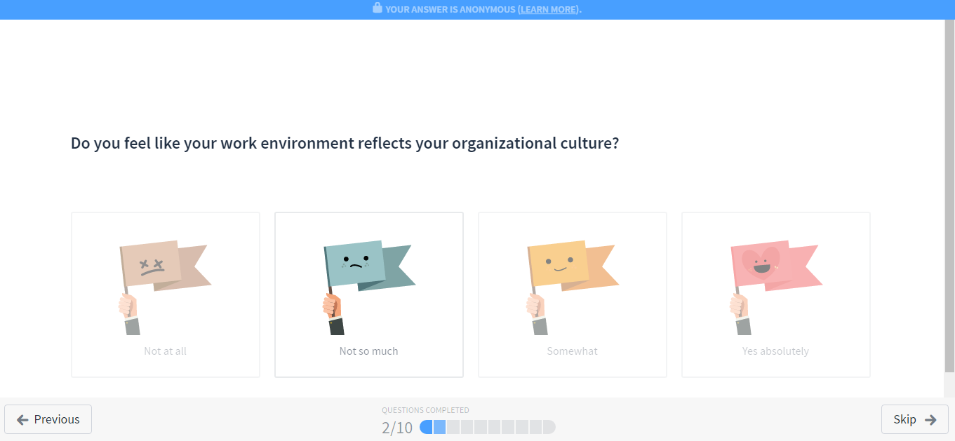
To Be Continued
29
A great tool to collect feedback and then learn from it to improve our company.
Your answers are ALWAYS anonymous unless you decide otherwise.
See the link below for more
https://www.officevibe.com/blog/officevibe-handles-employee-survey- privacy
*Strictly for internal purposes only, Ver.1-Jan'18

Slide 30
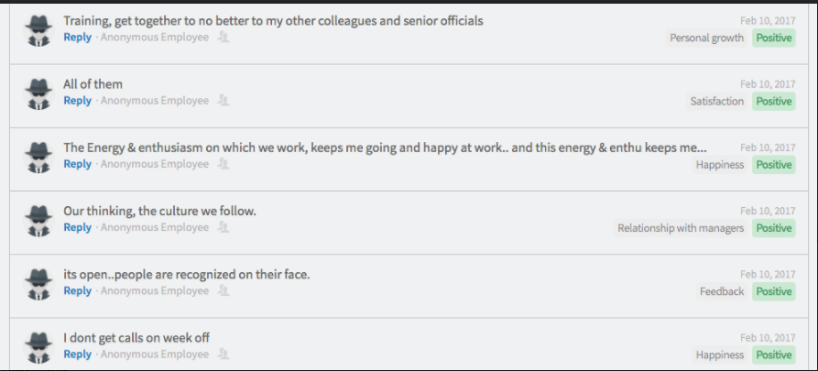
To Be Continued
30
These are the actual “anonymous feedback” screenshot to prove that it is indeed anonymous.
*Strictly for internal purposes only, Ver.1-Jan'18

Slide 31
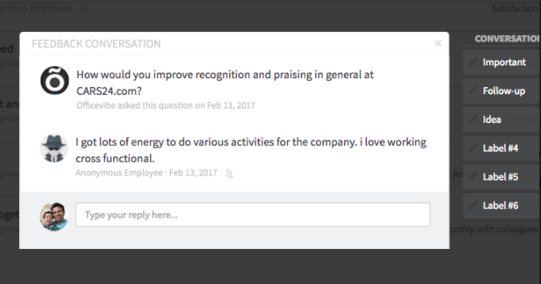
To Be Continued
31
*Strictly for internal purposes only, Ver.1-Jan'18

Slide 32
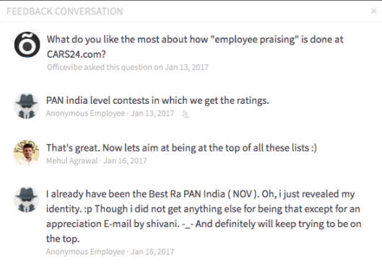
To Be Continued
34
*Strictly for internal purposes only, Ver.1-Jan'18

Slide 33
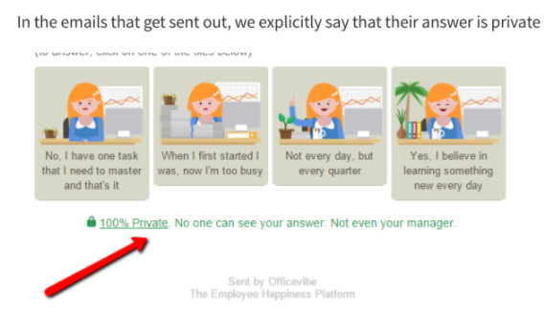
To Be Continued
35
*Strictly for internal purposes only, Ver.1-Jan'18

Slide 34
Your Digital Support
*Strictly for internal purposes only, Ver.1-Jan'18

Slide 35

Happay - Your Bill Raising Portal
37
Welcome
To
HAPPAY!
Employee will receive welcome email from Happay.
Employee can then activate Happay Account.
Employee can then login using his mobile number and password
Employee can add expenses, view summary of transactions, generate expense reports
Once the employee attaches the relevant bills and creates an expense report, it goes to the Manager for approval
Employee
Action
Manager
Action
Once Manager accepts employee requests, the same goes to finance for approval. When approved, the amount is credited within 2-3 working days
Let’s go through the portal - https://www.happay.in/
*Strictly for internal purposes only, Ver.1-Jan'18

Slide 36
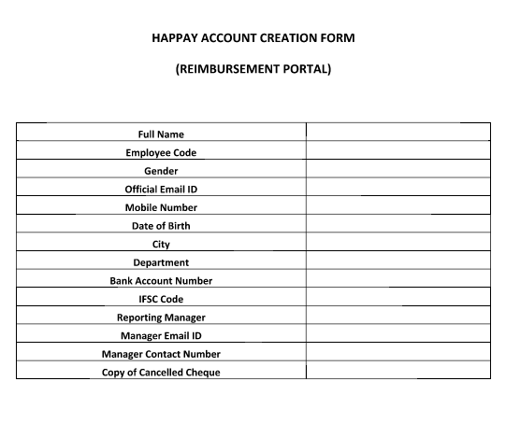

Happay - Your Bill Raising Portal
38
Let’s go through the portal - https://www.happay.in/
Below given details to be filled in a google form which will be shared by HR, attach the Manager approval along
*Strictly for internal purposes only, Ver.1-Jan'18

Slide 37
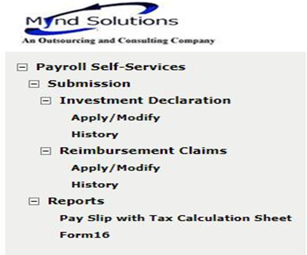
Mynd Portal - One Stop Solution For Payroll Queries
39
https://mypay.myndsolution.com/Login.aspx
For Declaring the investments
For downloading the salary slips
For downloading the Form 16
*Strictly for internal purposes only, Ver.1-Jan'18

Slide 38
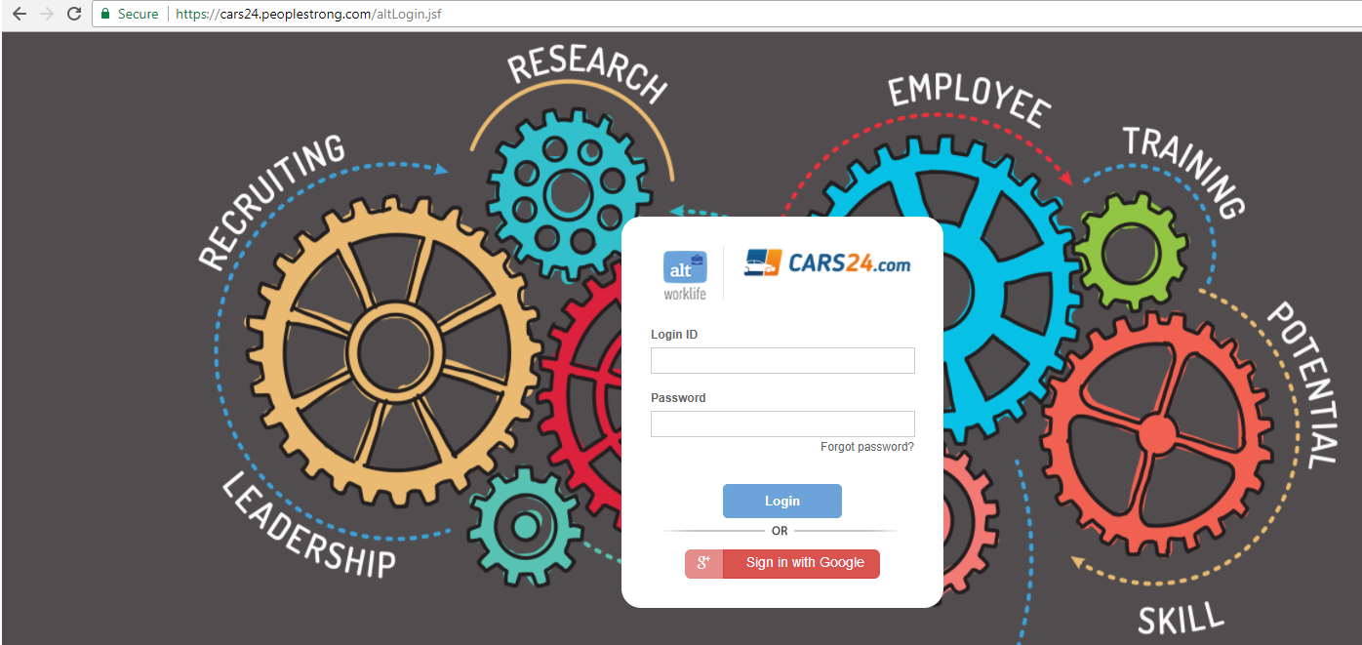
HRMS Portal - Simplifying Your Daily Work life
40
*Strictly for internal purposes only, Ver.1-Jan'18

Slide 39
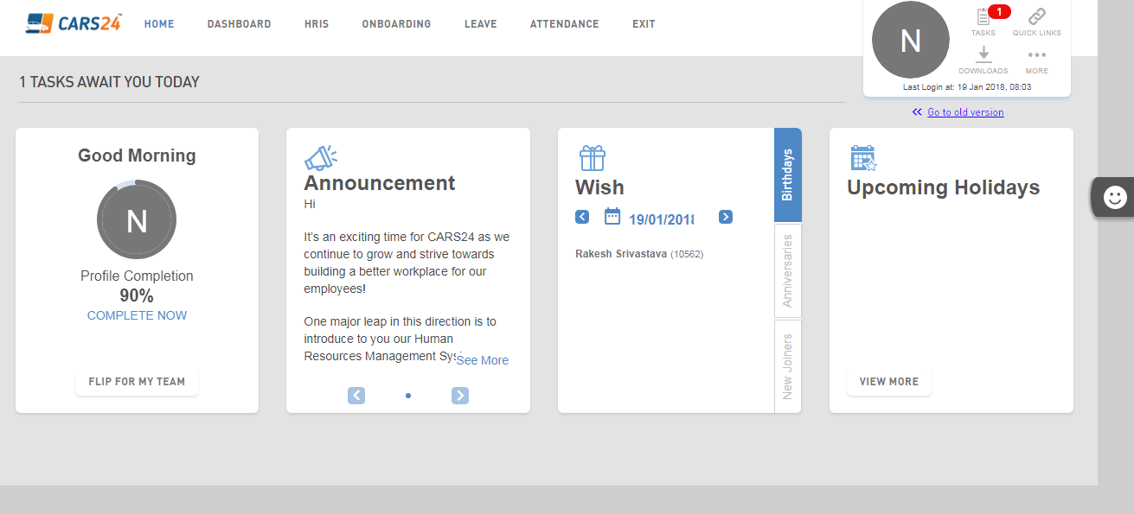
HRMS Portal
41
https://cars24.peoplestrong.com/altLogin.jsf - Let’s have a demo
*Strictly for internal purposes only, Ver.1-Jan'18

Slide 40
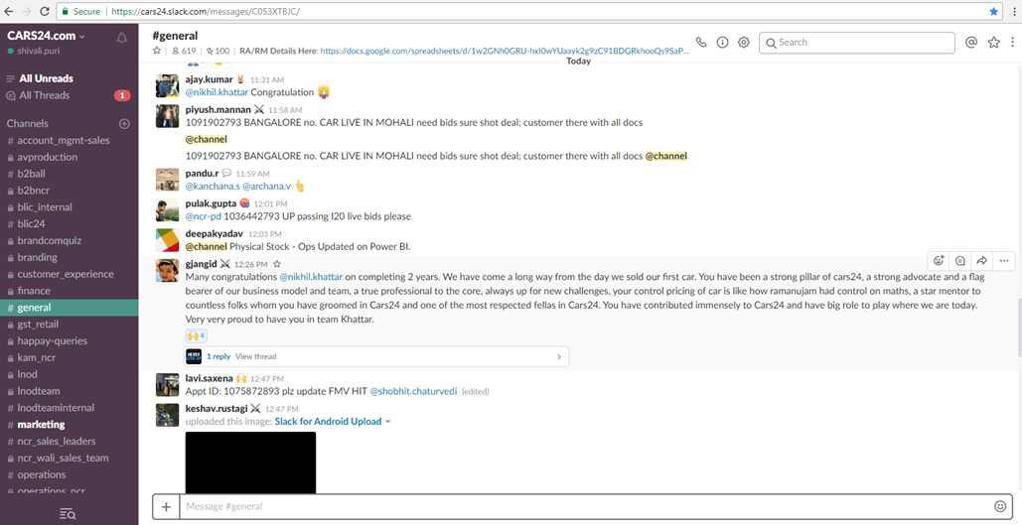
Slack Portal
42
How to get this activated, use the below given URL , linked to gmail account https://cars24.slack.com
*Strictly for internal purposes only, Ver.1-Jan'18

Slide 41
Key Contacts & Referral Scheme
*Strictly for internal purposes only, Ver.1-Jan'18

Slide 42
Your Key Contact Points
44
HUMAN RESOURCES - HRBP is your SPOC
Shivi Agrawal - shivi.agrawal@cars24.com
Pronami Borah - pronami.borah@cars24.com
IT - Asset handover and biometric activation and management
itsupport@cars24.com
Ravindra Singh - ravindra.singh@cars24.com
ADMIN - Travel desk management, parking allotment, and stationery management
Imran Khan- imran.khan@cars24.com
PAYROLL + PF + ESIC + SALARY STRUCTURE
Sandeep Tiwari - payroll.executive@cars24.com
*Strictly for internal purposes only, Ver.1-Jan'18

Slide 43

Also… Refer & Earn
45
This policy is to encourage employees to refer qualified experienced professionals for open positions in the company
*Strictly for internal purposes only, Ver.1-Jan'18

Slide 44
In continuous effort to evolve as a great work place, we all are equally responsible and therefore this is the
Time To Take An Oath
*Strictly for internal purposes only, Ver.1-Jan'18

Slide 45

Time To Take An Oath
47
I, solemnly take the pledge to uphold the goals, mission, and vision of Cars24.
I, pledge to perform my duties to best of my capabilities.
I, pledge to follow the code of conduct and will respect everyone at the workplace.
*Strictly for internal purposes only, Ver.1-Jan'18

Slide 46

FAQ’s
48
Group Medical Insurance
Employee State Insurance Corporation (ESIC)
Exit formalities
Let’s go through the link - https://drive.google.com/drive/folders/0B9IyHZjykX-zcDd3ZGpXcjZKWlU
*Strictly for internal purposes only, Ver.1-Jan'18

Slide 47





Slide 48


THANK YOU!
*Strictly for internal purposes only, Ver.1-Oct'17

